Slide 1
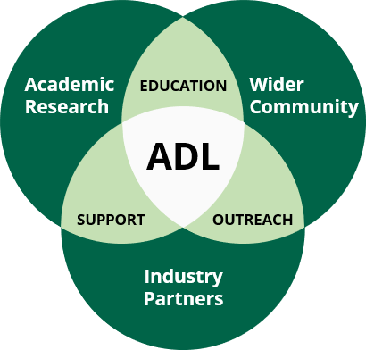
ADL Overview
Founded in 2007 — the ADL exists to facilitate interdisciplinary, collaborative research at BU through centralized user facilities; in alignment with the goals of BU’s Strategic Priority Roadmap.
ADL is staffed by a dedicated team of scientists and engineers, with extensive expertise in the R&D of materials; hard, soft, and everything in between.
It’s imperative that we expand our collection of scientific instrumentation to fulfill the evolving needs of our R1 research community and Industry partners.
Material Science & Engineering
Health Sciences
MSCF
SSCF
NLAB
HSCF
ADL

Slide 2
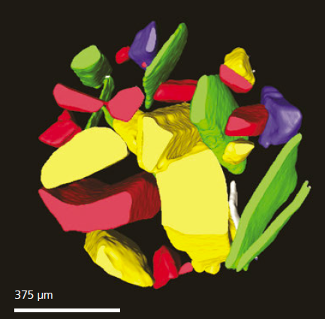
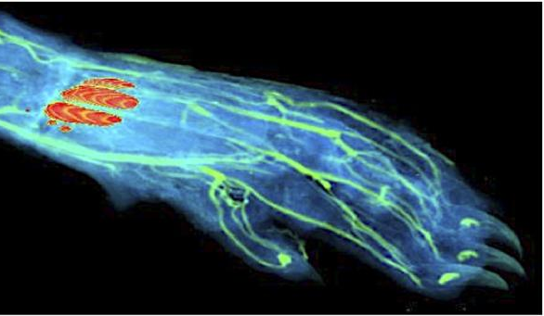
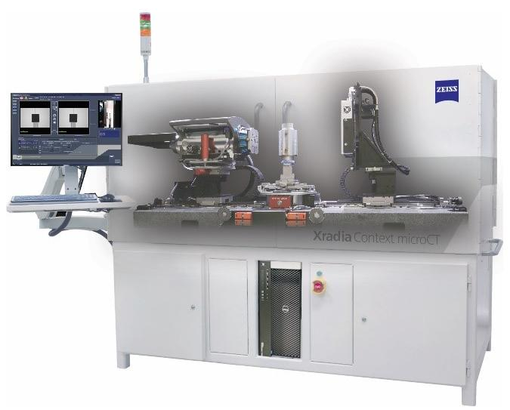
ADL Expansion: Materials Science Core Facility (MSCF)
8000 ft², established 2007
50 pieces of major instrumentation (upgraded/new 2021)
Sample Prep Suite
Optical Microscopy Suite
Thermal / Mechanical Suite
Electron Microscopy Suite
PFIB-SEM
TEM
Multiple FE-SEMs
X-ray Analysis Suite
XRD w/ Hot Stage
X-ray tomography
Smartwatch PCB
Equipment Spotlight: Xradia CT Scan

Slide 3
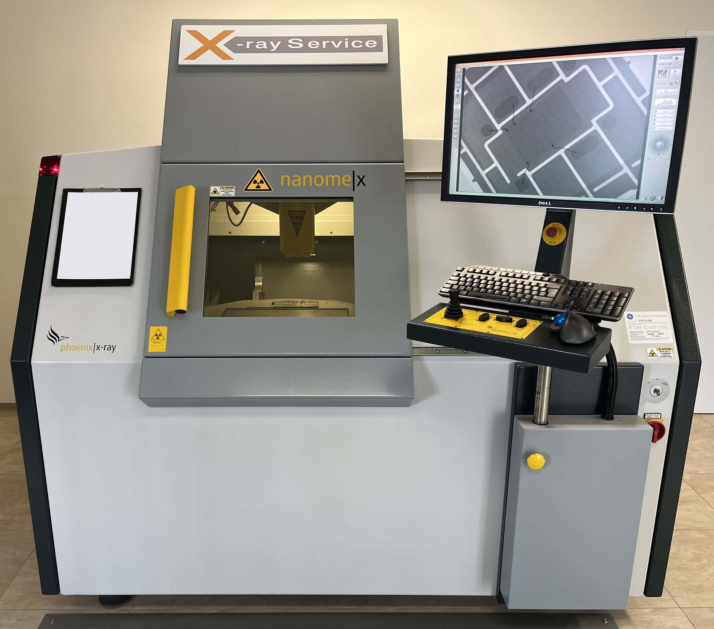
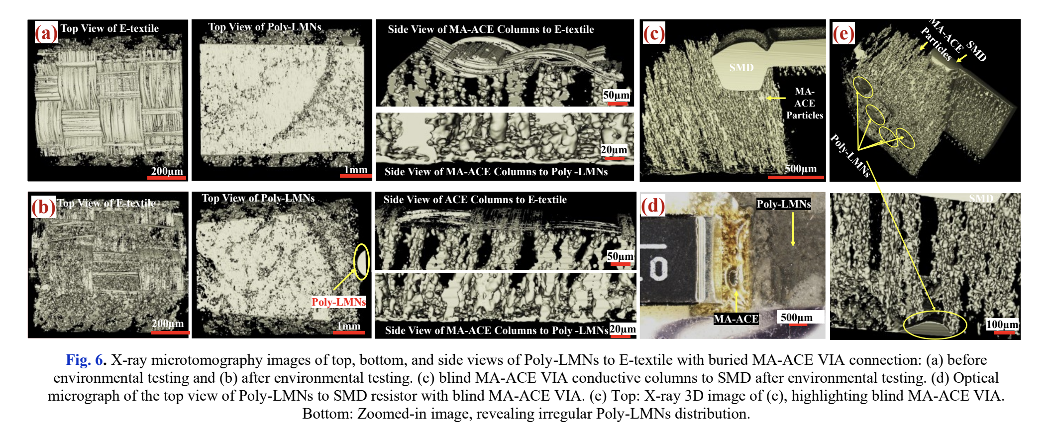
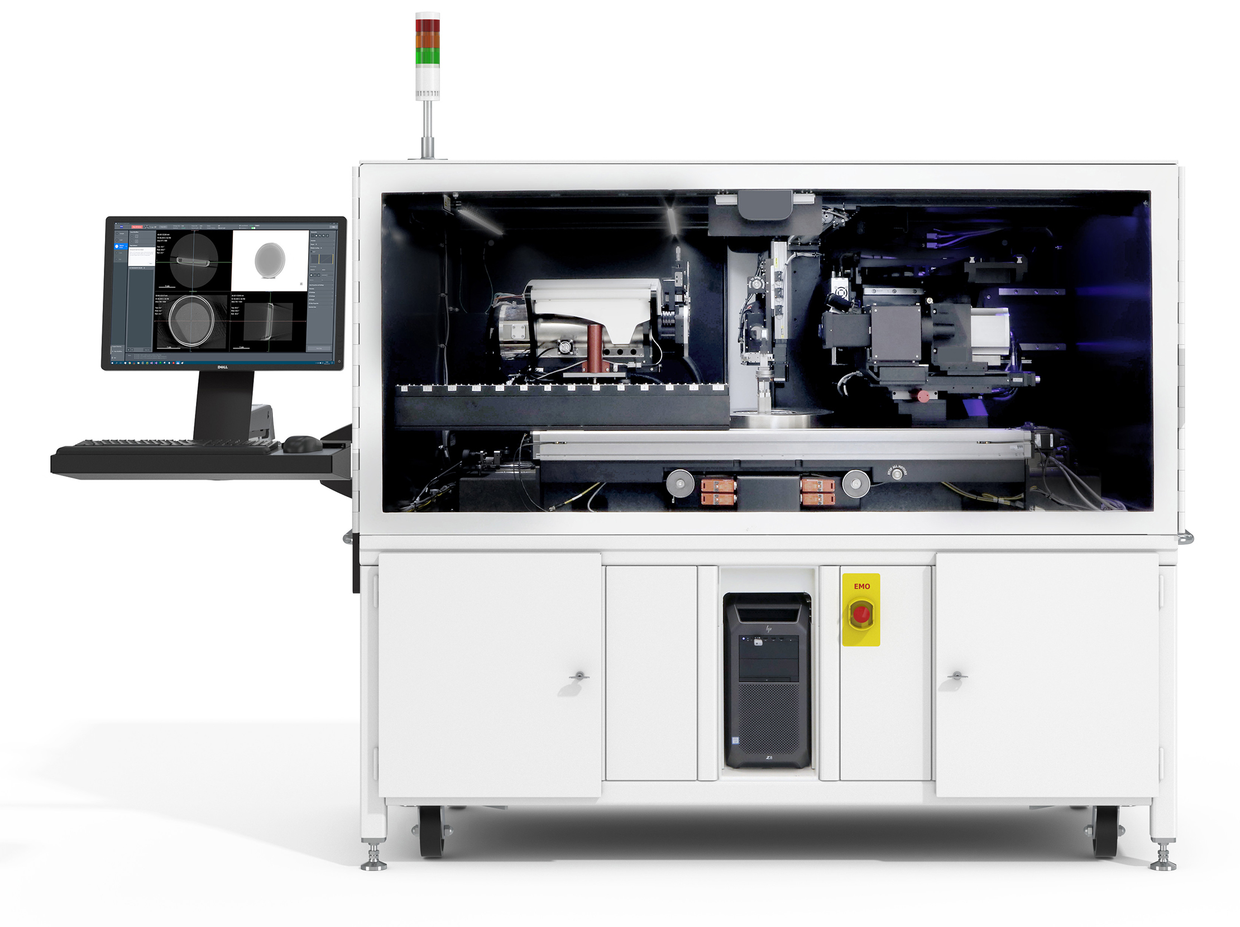
Nondestructive Microtomography
on Printed Interconnects
GE Phoenix Nanomex (4 µm)
Zeiss X-Radia (0.4 µm)
X-ray microscopy/tomography is a key technique to study embedded interfaces

Slide 4
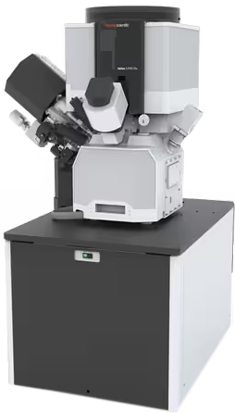
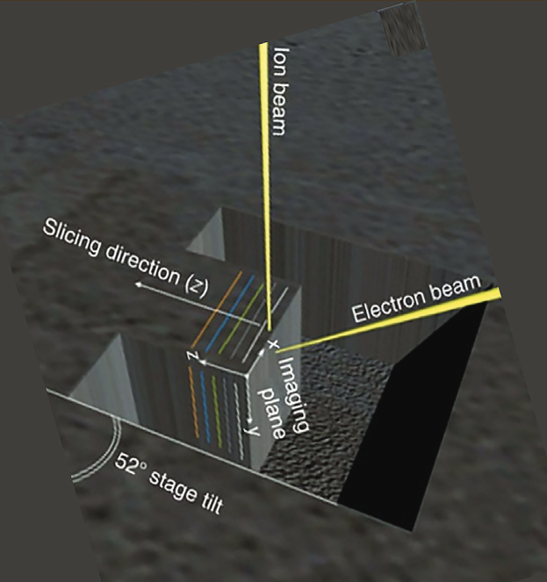
ADL Expansion: Materials Science Core Facility (MSCF)
Plasma Focused Ion Beam - Scanning Electron Microscopy (PFIB-SEM)
Uses a beam of plasma (Xe, Ar, O, N) combined with electron imaging for precise nanoscale machining, deposition, and characterization.
The capabilities of this new PFIB-SEM will greatly advance BU’s battery, bio, and CHIPS Act related research.
Fast milling for electronics packages
Inert transfer system for Li-ion batteries
Cryo-stage for delicate & bio-materials
Xe
Ar
O
N
Ready for ADL users June 2025!

Slide 5
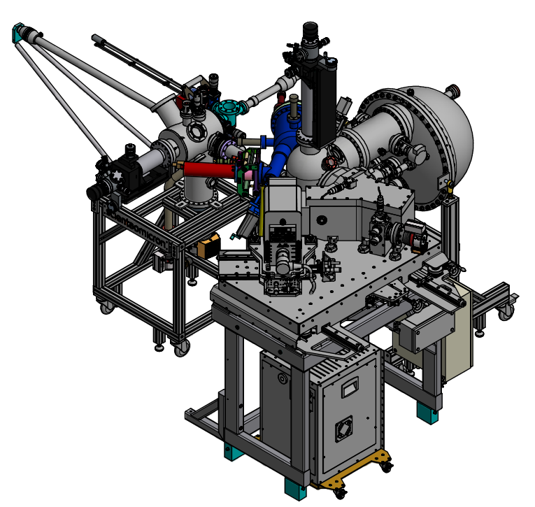
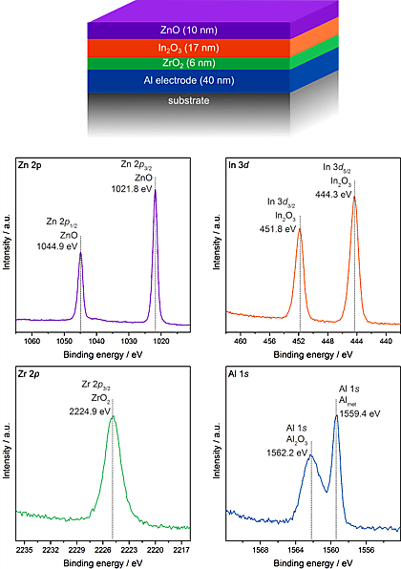
ADL Expansion: Surface Science Core Facility (SSCF)
3000 ft², established 2022
10 pieces of major instrumentation with future expansion plans
Surface Analysis Suite
HAXPES-Lab
EasyXAFS w/ Cell Cycler
FTIR
Raman
AFM
Optical & Stylus Profilers
Sample Prep Suite
Argon Glovebox
w/ UHV Transfer Suitcase
Fume Hoods & Sinks
Equipment Spotlight: HAXPES-Lab

Slide 6
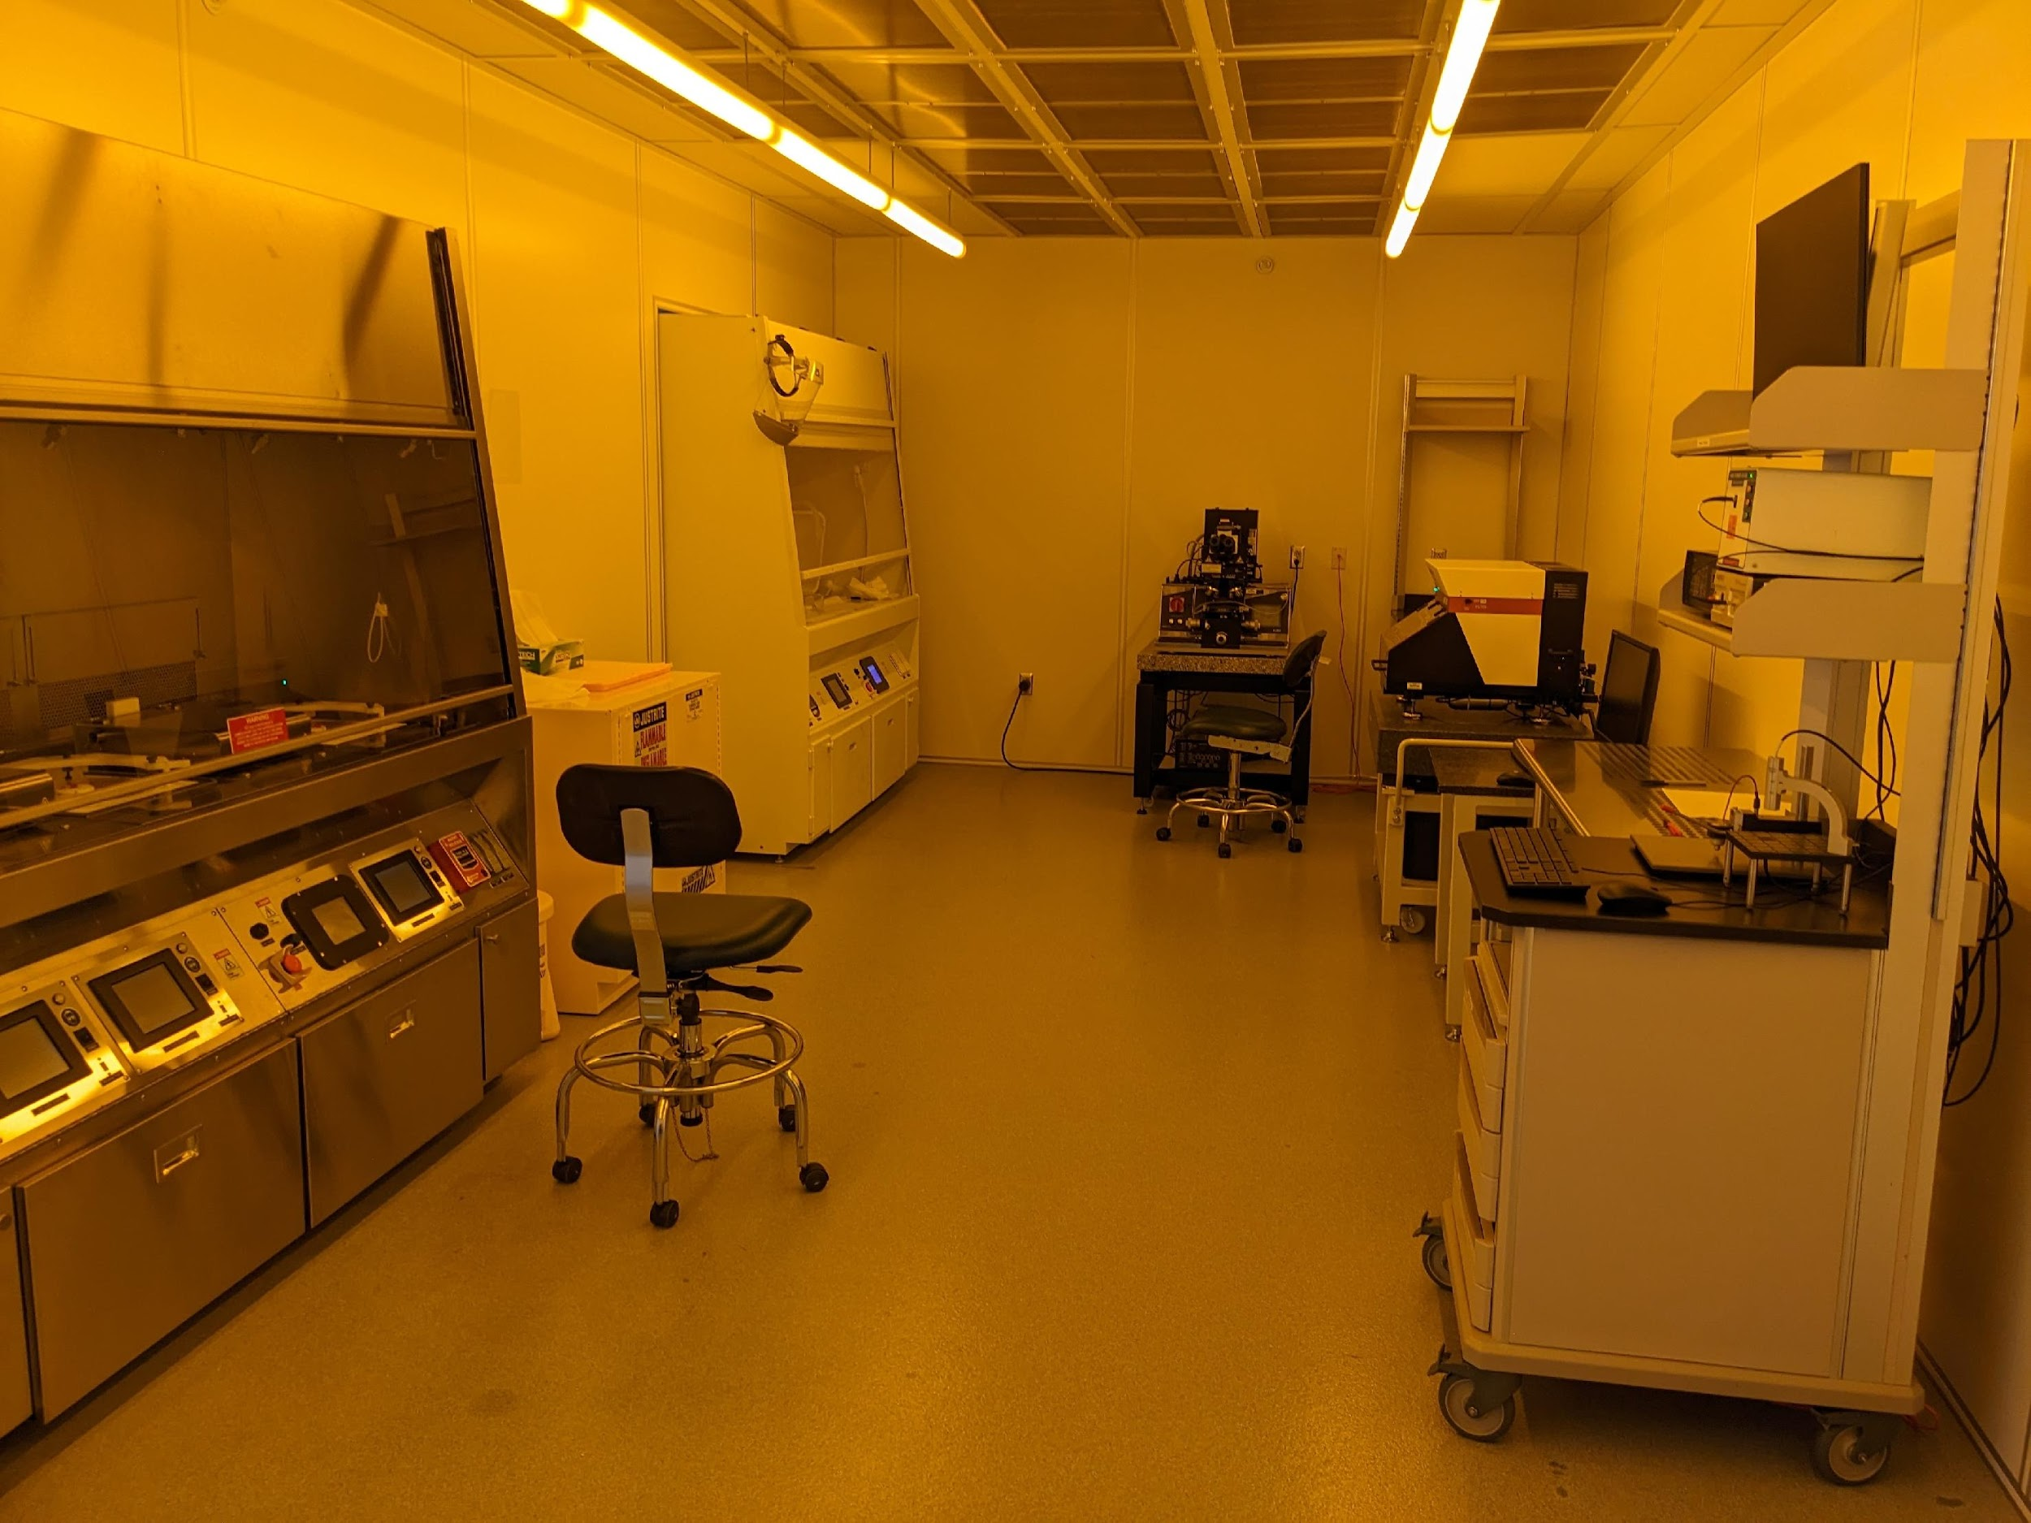
ADL Expansion: Nanofabrication Laboratory (NLAB)
1150 ft² class 1000 cleanroom space for 4” wafer process, established 2015
Photolithography Bay
Mask/Contact Aligner
Pattern Generator
UV-Vis & 4-pt Probe
Deposition & Wet Etching Bay
RF Magnetron Sputter
E-beam Evaporator
ALD
Metrology & Processing Bay
RIE & Deep RIE
Profilometer
Microscopes
$1 million approved for upgrading instrumentation

